Slide 1
Java Swing

Slide 2
The origins of the Swing
The AWT components use native code resources and referred to as heavyweight.
The native use of peers led to several problems
Because of variations between OS, a component might look, or even act differently on different platforms – threatened the overreaching philosophy of java: write once, run anywhere
The look and feel of each component was fixed and could not be changed
The use of heavyweight components caused some frustrating restrictions
Hence a better approach was needed - Swing

Slide 3
Swing does not replace AWT, but it is built on the foundation of AWT. It also uses the same event handling mechanism as the AWT
The limitations of AWT is removed through two key features: lightweight components and a pluggable look and feel – define the essence of Swing
Lightweight means – they are entirely written in java and do not map directly to platform peers
Because lightweight components are rendered using graphics primitives, they can be transparent, enabling nonrectangular shapes. These are more efficient and more flexible
Look and feel of each component is determined by Swing, not by the underlying OS

Slide 4
Look and feel is under the control of Swing
It is possible to separate the look and feel of a component from the logic of the component
Advantage: it becomes possible to change the way that a component is rendered without affecting any of its other aspects. It is possible to plug in a new look and feel for any given component with out creating any side effects in the code that uses that component
It becomes possible to define entire sets of look-and-feel that represent different GUI styles
To use a specific style, its look and feel is “plugged in”
Then all components are rendered using that style
It is possible to define a look and feel that is consistent across all platforms (it acts like a specific platform)

Slide 5
MVC (Model-View-Controller) Connection
In general a visual component has 3 distinct aspects
i) The way that the component looks when rendered on screen
ii) The way that the component reacts to the user
iii) The state information associated with the component
Model-state information
View-display of component
Controller-how component reacts to user

Slide 6
Checkbox-model contains a field that indicates if it is selected or not
View –indicates its display
Controller-when user clicks the checkbox the controller reacts by changing the model to reflect user’s choice and then result in change of view
Swing- view+controller(UIdelegate) , model– modeldelegate/separatemodel architecture.
Most swing components contain 2 objects
Model +UIdelegate
ButtonModel interface+ButtonUI class derived from component UI.

Slide 7
Components and containers
Swing GUI is madeup of components and containers. This distinction is conceptual because a container is also a component.
The difference lies based on their usage.
A component is independent visual control
A container is a special type of component that holds a group of components
For a component to be displayed it should be held in a container.
A swing GUI thus should have at least one container.

Slide 8
Because container is a component it can hold other containers also.
Components
Swing components are derived from JComponent class which inherits awt component and container class
It supports pluggable look and feel
All swing components are found in javax.swing package.
Eg: JApplet,Jframe,Jbutton,JCheckBox……

Slide 9
Containers
Two types of containers
Top-level containers namely JFrame, JApplet, JWindow, JDialog these do not inherit Jcomponent, however inherit component and containers of awt and are heavy weight.
A top-level container is not contained with in any other container. For applications – JFrame and for applets - JApplet
Lightweight containers (can be contained with in another container) which inherit Jcomponent. Eg. JPanel

Slide 10
Top-level Container Panes
Each top level container inherits JRootPane( a lightweight container). Its functionality is to manage other panes and menubar.
Root pane contains glasspane, layeredpane, contentpane. Glasspane(instance of Jpanel &transparent) sits above and completely covers all other panes. It enables to manage mouse events or to paint over any other component. The layeredpane(insatnce of JLayeredPane) allows components to be given a depth value
We add components to contentpane ( an opaque instance of Jpanel).

Slide 11
Swing application
Constructor is invoked using the lines of code:
  SwingUtilities.invokeLater(new Runnable() { public void run() { new classname(); } });
  Class object is created on the event dispatching thread
  Swing programs are event-driven
  When user interacts with a component an event is generated
  Event is passed to the application by calling an event handler defined in the application

Slide 12
But, handler is executed on the event dispatching thread provided by Swing and not on the main thread of the application
Event handlers are called on the thread that is not created by the program
All swing GUI components are created and updated from event dispatching thread, and not the main thread
Main is executed from the main thread
Main cannot directly instantiate a class object, it must create a Runnable object that executes on the event dispatching thread and have this object create the GUI

Slide 13
To enable the GUI code to be created on the event dispatching thread, use the methods defined by SwingUtilities class- invokeLater() and invokeAndWait()
Static void invokeLater(Runnable obj)
  Returns immediately
Static void invokeAndWait(Runnable obj) throws InterruptedException, InvocationTargetException
  Waits until obj.run() returns
void setDefaultCloseOperation(int what)
Value of what - JFrame.EXIT _ON_CLOSE
Other options HIDE_ON_CLOSE , DISPOSE_ON_CLOSE
DO_NOTHING_ON_CLOSE
Constants declared in WindowConstants- an interface declared in javax.swing implemented by JFrame

Slide 14
// A simple Swing Application
import javax.swing.*;
class SwingDemo {
SwingDemo() {
// Create a new JFrame container.
JFrame jfrm = new JFrame("A Simple Swing Application");
// Give the frame an initial size.
jfrm.setSize(275, 100);
// Terminate the program when the user closes the application.
jfrm.setDefaultCloseOperation(JFrame.EXIT_ON_CLOSE);
// Create a text-based label.
JLabel jlab = new JLabel(" Swing means powerful GUIs.");

Slide 15
// Add the label to the content pane.
jfrm.add(jlab);
// Display the frame.
jfrm.setVisible(true);
}
public static void main(String args[]) {
// Create the frame on the event dispatching thread.
SwingUtilities.invokeLater(new Runnable() {
public void run() {
new SwingDemo();
} } );
} }

Slide 16
Events specific to Swing are stored in javax.swing.event
// Handle an event in a Swing program.
import java.awt.*;
import java.awt.event.*;
import javax.swing.*;
class EventDemo {
JLabel jlab;
EventDemo() {
// Create a new JFrame container.
JFrame jfrm = new JFrame("An Event Example");
// Specify FlowLayout for the layout manager.
jfrm.setLayout(new FlowLayout());
// Give the frame an initial size.
jfrm.setSize(220, 90);

Slide 17
// Terminate the program when the user closes the application.
jfrm.setDefaultCloseOperation(JFrame.EXIT_ON_CLOSE);
// Make two buttons.
JButton jbtnAlpha = new JButton("Alpha");
JButton jbtnBeta = new JButton("Beta");
// Add action listener for Alpha.
jbtnAlpha.addActionListener(new ActionListener() {
public void actionPerformed(ActionEvent ae) {
jlab.setText("Alpha was pressed.");
} });
// Add action listener for Beta.
jbtnBeta.addActionListener(new ActionListener() {
public void actionPerformed(ActionEvent ae) {
jlab.setText("Beta was pressed."); } });

Slide 18
// Add the buttons to the content pane.
jfrm.add(jbtnAlpha);
jfrm.add(jbtnBeta);
// Create a text-based label.
jlab = new JLabel("Press a button.");
// Add the label to the content pane.
jfrm.add(jlab);
// Display the frame.
jfrm.setVisible(true);
}
public static void main(String args[]) {
// Create the frame on the event dispatching thread.
SwingUtilities.invokeLater(new Runnable() {
public void run() {
new EventDemo(); } }); } }

Slide 19
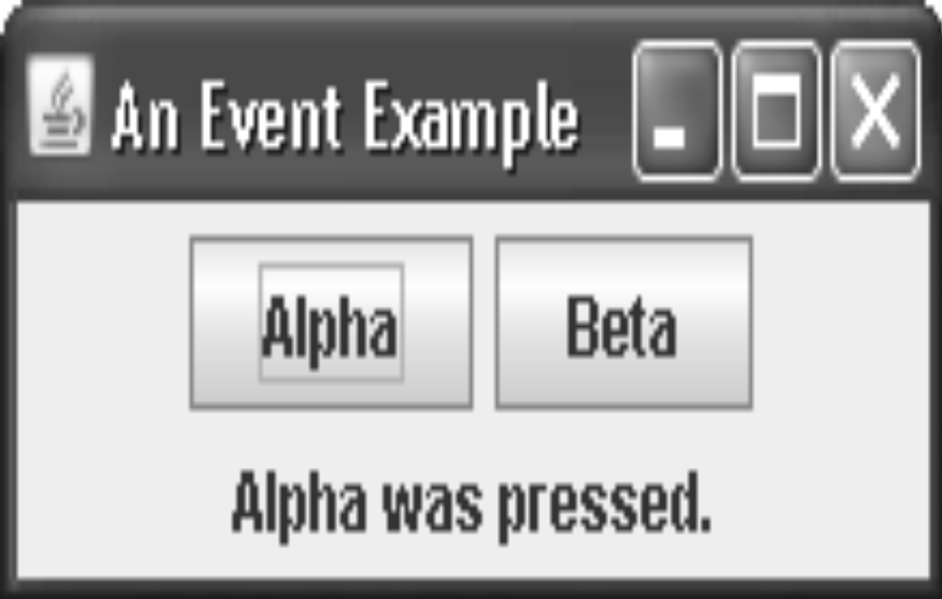

Slide 20
Swing Applet
All interaction with components in a swing applet must take place on the event dispatching thread – applies to all swing programs
// A simple Swing-based applet
import javax.swing.*;
import java.awt.*;
import java.awt.event.*;
/*
This HTML can be used to launch the applet:
<object code="MySwingApplet" width=220 height=90>
</object>
*/

Slide 21
public class MySwingApplet extends JApplet {
JButton jbtnAlpha;
JButton jbtnBeta;
JLabel jlab;
// Initialize the applet.
public void init() {
try {
SwingUtilities.invokeAndWait(new Runnable () {
public void run() {
makeGUI(); // initialize the GUI
} });
} catch(Exception exc) {
System.out.println("Can't create because of "+ exc);
}
}

Slide 22
// This applet does not need to override start(), stop(), or destroy().
// Setup and initialize the GUI.
private void makeGUI() {
// Set the applet to use flow layout.
setLayout(new FlowLayout());
// Make two buttons.
jbtnAlpha = new JButton("Alpha");
jbtnBeta = new JButton("Beta");
// Add action listener for Alpha.
jbtnAlpha.addActionListener(new ActionListener() {
public void actionPerformed(ActionEvent le) {
jlab.setText("Alpha was pressed.");
}
});

Slide 23
// Add action listener for Beta.
jbtnBeta.addActionListener(new ActionListener() {
public void actionPerformed(ActionEvent le) {
jlab.setText("Beta was pressed.");
}
});
// Add the buttons to the content pane.
add(jbtnAlpha);
add(jbtnBeta);
// Create a text-based label.
jlab = new JLabel("Press a button.");
// Add the label to the content pane.
add(jlab);
}
}

Slide 24
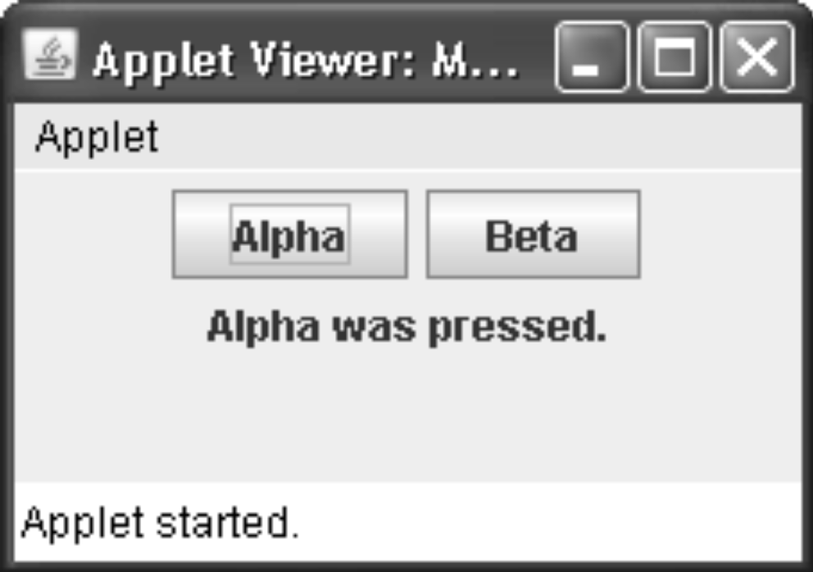

Slide 25
All swing based applets extend JApplet
The init () method initializes the Swing components on the event dispatching thread by setting up a call to MakeGUI()
This is accomplished through the use of InvokeAndWait() because init() must not return until the entire initialization process has been completed
The start() called until after initialization, which means that the GUI must be fully constructed
Inside MakeGUI(), two buttons and label are created, and the action listeners are added to the buttons. Then the components are added to the content pane
This general approach must be used when building any Swing GUI, used by an applet

Slide 26
Introduction
Swing is a set of classes that provides more powerful and flexible components than are possible with the AWT.
Swing supplies several exciting additions, including tabbed panes, scroll panes, trees, and tables.
Swing components are written entirely in Java and, therefore, are platform-independent.

Slide 27
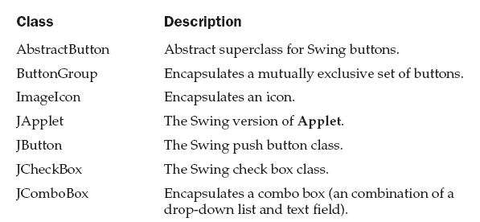
Introduction
The number of classes and interfaces in the Swing packages is fairly large, and this chapter provides an overview of just a few components
The Swing-related classes are contained in javax.swing

Slide 28
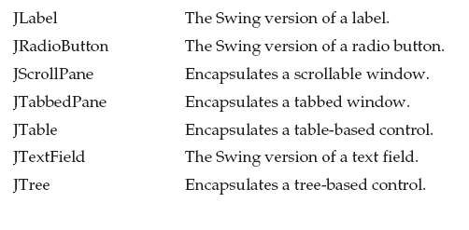
Introduction
The number of classes and interfaces in the Swing packages is fairly large, and this chapter provides an overview of just a few components

Slide 29
JApplet
Fundamental to Swing is the JApplet class, which extends Applet
Applets that use Swing must be subclasses of JApplet
Japplet provides enhanced features which are not in Applet
When adding a component to an instance of JApplet, call add( ) for the content pane of the Japplet object.
(Not add( ) method of the applet) – JDK5
In JDK6 you can call add() directly on JFrame

Slide 30
JApplet
The content pane can be obtained via the method shown here:
Container getContentPane( )
The add( ) method of Container can be used to add a component to a content pane.
void add(comp)
comp →the component to be added to the content pane.

Slide 31
Icons and Labels
In Swing, icons are encapsulated by the ImageIcon class
Two of its constructors are shown here
      ImageIcon(String filename)
      ImageIcon(URL url)
The first form uses the image in the file named filename.
The second form uses the image in the resource identified by url.

Slide 32
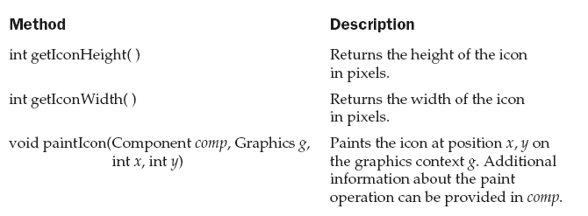
Icons and Labels
The ImageIcon class implements the Icon interface that declares the methods shown here

Slide 33
Icons and Labels
Swing labels are instances of the JLabel class, which extends JComponent
It can display text and/or an icon. Some of its constructors are shown here
JLabel(Icon i)
JLabel(String s)
JLabel(String s, Icon i, int align)

Slide 34
Icons and Labels
s and i → the text and icon used for the label.
align → either LEFT, RIGHT, CENTER, LEADING, or TRAILING.
  These constants are defined in the SwingConstants interface

Slide 35
Icons and Labels
The icon and text associated with the label can be read and written by the following methods:
      Icon getIcon( )
      String getText( )
      void setIcon(Icon i)
      void setText(String s)
Here, i and s are the icon and text, respectively

Slide 36
Example
The following example illustrates how to create and display a label containing both an icon and a string.
private void makeGUI() {
// Create an icon.
ImageIcon ii = new ImageIcon("france.gif");
// Create a label.
JLabel jl = new JLabel("France", ii, JLabel.CENTER);
// Add the label to the content pane.
add(jl);
} }

Slide 37
Example
// Demonstrate JLabel and ImageIcon.
import java.awt.*;
import javax.swing.*;
/*
<applet code="JLabelDemo" width=250 height=150>
</applet>
*/
public class JLabelDemo extends JApplet {
public void init() {
try {
SwingUtilities.invokeAndWait(
new Runnable() {
public void run() {
makeGUI();
} } );
} catch (Exception exc) {
System.out.println("Can't create because of " + exc);
}
}

Slide 38
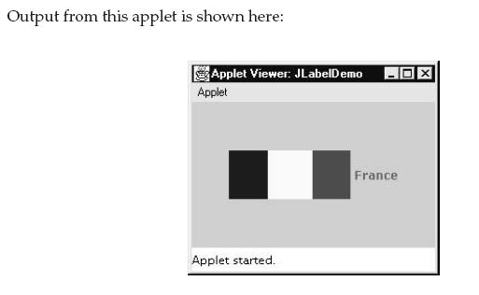
Example

Slide 39
Text Fields
The Swing JTextField is a subclass JTextComponent class, which extends JComponent.
Some of its constructors are shown here:
JTextField( )
JTextField(int cols)
JTextField(String s, int cols)
JTextField(String s)
cols → the number of columns in the text field

Slide 40
// Demonstrate JTextField.
import java.awt.*;
import java.awt.event.*;
import javax.swing.*;
/*
<applet code="JTextFieldDemo" width=300 height=50>
</applet>
*/
public class JTextFieldDemo extends JApplet {
JTextField jtf;
public void init() {
try {
SwingUtilities.invokeAndWait(
new Runnable() {
public void run() {
makeGUI();
} } );

Slide 41
} catch (Exception exc) {
System.out.println("Can't create because of " + exc);
} }
private void makeGUI() {
// Change to flow layout.
setLayout(new FlowLayout());
// Add text field to content pane.
jtf = new JTextField(15);
add(jtf);
jtf.addActionListener(new ActionListener() {
public void actionPerformed(ActionEvent ae) {
// Show text when user presses ENTER.
showStatus(jtf.getText());
} }); } }

Slide 42
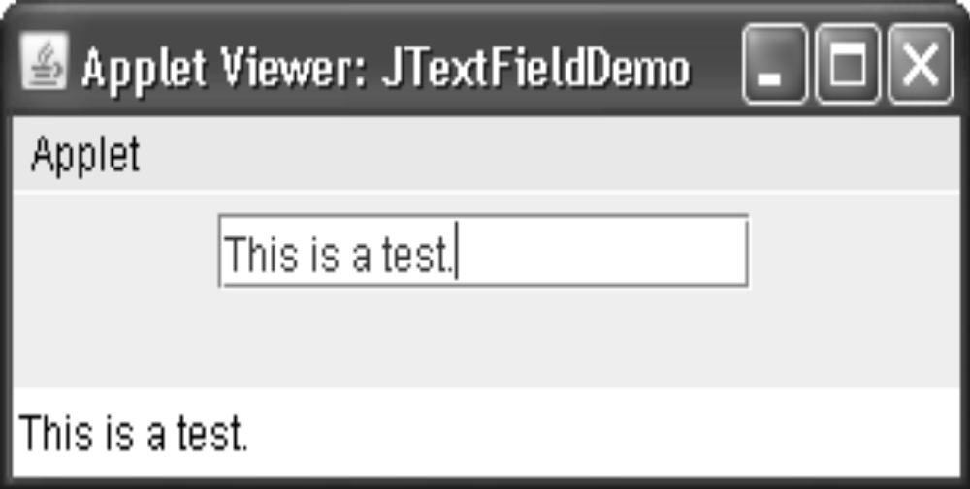
A CaretEvent is fired each time the caret (i.e., the cursor) changes position. (CaretEvent is packaged in javax.swing.event.)

Slide 43
Buttons
Swing defines four types of buttons: JButton, JToggleButton, JCheckBox, and JRadioButton.
All are subclasses of the AbstractButton class, which extends JComponent.
AbstractButton contains many methods that allow you to control the behavior of buttons.
For example, you can define different icons that are displayed for the button when it is disabled, pressed, or selected. Another icon can be used as a rollover icon, which is displayed when the mouse is positioned over a button.

Slide 44
Buttons
The following methods set these icons:
void setDisabledIcon(Icon di)
void setPressedIcon(Icon pi)
void setSelectedIcon(Icon si)
void setRolloverIcon(Icon ri)
The text associated with a button can be read and written via the following methods:
String getText( )
void setText(String str)
The model used by all buttons is defined by the ButtonModel interface. A button generates an action event when it is pressed.

Slide 45
The JButton Class
JButton allows an icon, a string, or both to be associated with the push button. When button is pressed, an ActionEvent is generated.
Some of its constructors are shown here:
JButton(Icon i)
JButton(String s)
JButton(String s, Icon i)

Slide 46
Example:
JButton allows an icon, a string, or both to be associated with the push button. Some of its constructors are shown here:
// Demonstrate an icon-based JButton.
import java.awt.*;
import java.awt.event.*;
import javax.swing.*;
/* <applet code="JButtonDemo" width=250 height=450>
</applet> */
public class JButtonDemo extends JApplet
implements ActionListener {
JLabel jlab;

Slide 47
Example:
public void init() {
try {
SwingUtilities.invokeAndWait(
new Runnable() {
public void run() {
makeGUI();
}
}
);
} catch (Exception exc) {
System.out.println("Can't create because of " + exc);
}
}
private void makeGUI() {
// Change to flow layout.
setLayout(new FlowLayout());

Slide 48
Example:
// Add buttons to content pane.
ImageIcon france = new ImageIcon("france.gif");
JButton jb = new JButton(france);
jb.setActionCommand("France");
jb.addActionListener(this);
add(jb);
ImageIcon germany = new ImageIcon("germany.gif");
jb = new JButton(germany);
jb.setActionCommand("Germany");
jb.addActionListener(this);
add(jb);
ImageIcon italy = new ImageIcon("italy.gif");
jb = new JButton(italy);
jb.setActionCommand("Italy");
jb.addActionListener(this);
add(jb);

Slide 49
ImageIcon japan = new ImageIcon("japan.gif");
jb = new JButton(japan);
jb.setActionCommand("Japan");
jb.addActionListener(this);
add(jb);
// Create and add the label to content pane.
jlab = new JLabel("Choose a Flag");
add(jlab);
}
// Handle button events.
public void actionPerformed(ActionEvent ae) {
jlab.setText("You selected " + ae.getActionCommand());
}
}

Slide 50
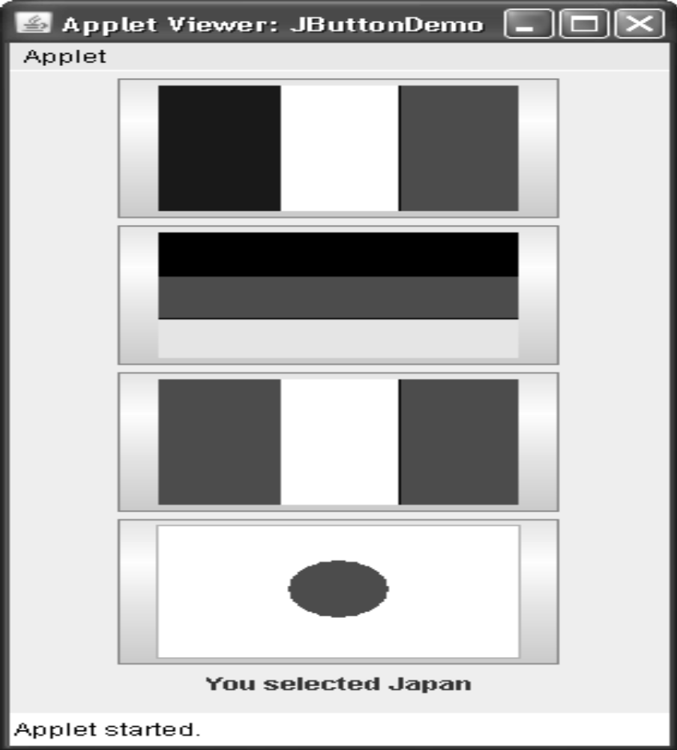
output of the program

Slide 51
JToggleButton
looks just like a push button, but it acts differently because it has two states: pushed and released.
when you press a toggle button, it stays pressed
When you press the toggle button a second time, it releases (pops up).
These are objects of the JToggleButton class. JToggleButton implements AbstractButton.
is a superclass for JCheckBox and JRadioButton
One of the several constructors-
JToggleButton(String str)

Slide 52
By default, the button is in the off position
generates an action event each time it is pressed.
JToggleButton also generates an item event. This event is used by those components that support the concept of selection. When a JToggleButton is pressed in, it is selected. When it is popped out, it is deselected.
to determine a toggle button’s state is by calling the isSelected( ) method - boolean isSelected( )
// Demonstrate JToggleButton.

Slide 53
import java.awt.*;
import java.awt.event.*;
import javax.swing.*;
/* <applet code="JToggleButtonDemo" width=200 height=80>
</applet> */
public class JToggleButtonDemo extends JApplet {
JLabel jlab;
JToggleButton jtbn;
public void init() {
try {
SwingUtilities.invokeAndWait( new Runnable() {

Slide 54
public void run() {
makeGUI();
}
} );
} catch (Exception exc) {
System.out.println("Can't create because of " + exc);
}
}
private void makeGUI() {
// Change to flow layout.
setLayout(new FlowLayout());
// Create a label.

Slide 55
// Make a toggle button.
jtbn = new JToggleButton("On/Off");
// Add an item listener for the toggle button.
jtbn.addItemListener(new ItemListener() {
public void itemStateChanged(ItemEvent ie) {
if(jtbn.isSelected())
jlab.setText("Button is on.");
else
jlab.setText("Button is off.");
}
});
// Add the toggle button and label to the content pane.
add(jtbn);

Slide 56
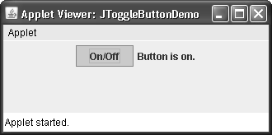
add(jlab);
}
}
The output :

Slide 57
Check Boxes
The JCheckBox class, which provides the functionality of a check box, is a concrete implementation of AbstractButton.
Its immediate superclass is JToggleButton
Some of its constructors are shown here:
JCheckBox(Icon i)
JCheckBox(Icon i, boolean state)
JCheckBox(String s)
JCheckBox(String s, boolean state)
JCheckBox(String s, Icon i)
JCheckBox(String s, Icon i, boolean state)
Method : void setSelected(boolean state)

Slide 58
Examples
// Demonstrate JCheckbox.
import java.awt.*;
import java.awt.event.*;
import javax.swing.*;
/*
<applet code="JCheckBoxDemo" width=270 height=50>
</applet> */
public class JCheckBoxDemo extends JApplet
implements ItemListener {
JLabel jlab;
public void init() {
try {
SwingUtilities.invokeAndWait(
new Runnable() {
public void run() {
makeGUI();
} } );

Slide 59
Examples
} catch (Exception exc) {
System.out.println("Can't create because of " + exc);
}
}
private void makeGUI() {
// Change to flow layout.
setLayout(new FlowLayout());
// Add check boxes to the content pane.
JCheckBox cb = new JCheckBox("C");
cb.addItemListener(this);
add(cb);
cb = new JCheckBox("C++");
cb.addItemListener(this);
add(cb);
cb = new JCheckBox("Java");
cb.addItemListener(this);
add(cb);

Slide 60
Examples
cb = new JCheckBox("Perl");
cb.addItemListener(this);
add(cb);
// Create the label and add it to the content pane.
jlab = new JLabel("Select languages");
add(jlab);
}
// Handle item events for the check boxes.
public void itemStateChanged(ItemEvent ie) {
JCheckBox cb = (JCheckBox)ie.getItem();
if(cb.isSelected())
jlab.setText(cb.getText() + " is selected");
else
jlab.setText(cb.getText() + " is cleared");
}
}

Slide 61
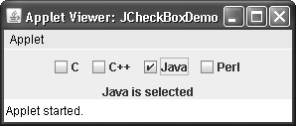
Examples

Slide 62
Radio Buttons
Radio buttons are supported by the JRadioButton class, which is a concrete implementation of AbstractButton.
Its immediate superclass is JToggleButton
Some of its constructors are shown here:
  JRadioButton(Icon i)
  JRadioButton(Icon i, boolean state)
  JRadioButton(String s)
  JRadioButton(String s, boolean state)
  JRadioButton(String s, Icon i)
  JRadioButton(String s, Icon i, boolean state)

Slide 63
Radio Buttons
The ButtonGroup class is instantiated to create a button group.
Its default constructor is invoked for this purpose.
Elements are then added to the button group via the following method:
void add(AbstractButton ab)
Here, ab is a reference to the button to be added to the group.
Generates action events(normally), item events and change events each time the button selection changes

Slide 64
Example
// Demonstrate JRadioButton
import java.awt.*;
import java.awt.event.*;
import javax.swing.*;
/*
<applet code="JRadioButtonDemo" width=300 height=50>
</applet>
*/
public class JRadioButtonDemo extends JApplet
implements ActionListener {
JLabel jlab;
public void init() {
try {
SwingUtilities.invokeAndWait(
new Runnable() {
public void run() {
makeGUI();
}
}
);

Slide 65
Example
} catch (Exception exc) {
System.out.println("Can't create because of " + exc);
}
}
private void makeGUI() {
// Change to flow layout.
setLayout(new FlowLayout());
// Create radio buttons and add them to content pane.
JRadioButton b1 = new JRadioButton("A");
b1.addActionListener(this);
add(b1);
JRadioButton b2 = new JRadioButton("B");
b2.addActionListener(this);
add(b2);
JRadioButton b3 = new JRadioButton("C");
b3.addActionListener(this);
add(b3);

Slide 66
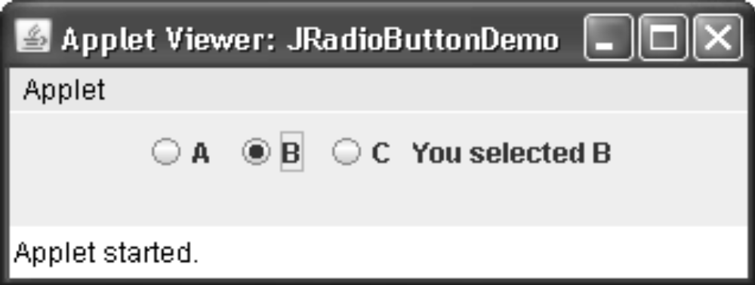
Example
// Define a button group.
ButtonGroup bg = new ButtonGroup();
bg.add(b1);
bg.add(b2);
bg.add(b3);
// Create a label and add it to the content pane.
jlab = new JLabel("Select One");
add(jlab);
}
// Handle button selection.
public void actionPerformed(ActionEvent ae) {
jlab.setText("You selected " + ae.getActionCommand()); } }

Slide 67
Combo Boxes
JComboBox class, which extends JComponent.
JComboBox’s constructors are shown here
JComboBox( )
JComboBox(Vector v)
Items are added to the list of choices via the addItem( ) method,
void addItem(Object obj)
Obj → the object to be added to the combo box

Slide 68
Example
// Demonstrate JComboBox.
import java.awt.*;
import java.awt.event.*;
import javax.swing.*;
/*
<applet code="JComboBoxDemo" width=300 height=100>
</applet> */
public class JComboBoxDemo extends JApplet {
JLabel jlab;
ImageIcon france, germany, italy, japan;
JComboBox jcb;
String flags[] = { "France", "Germany", "Italy", "Japan" };
public void init() {
try {
SwingUtilities.invokeAndWait(
new Runnable() {
public void run() {
makeGUI();
} } );

Slide 69
Example
} catch (Exception exc) {
System.out.println("Can't create because of " + exc);
}
}
private void makeGUI() {
// Change to flow layout.
setLayout(new FlowLayout());
// Instantiate a combo box and add it to the content pane.
jcb = new JComboBox(flags);
add(jcb);
// Handle selections.
jcb.addActionListener(new ActionListener() {
public void actionPerformed(ActionEvent ae) {
String s = (String) jcb.getSelectedItem();
jlab.setIcon(new ImageIcon(s + ".gif"));
}
});

Slide 70
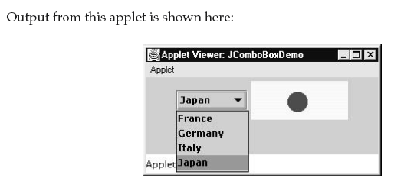
Example
// Create a label and add it to the content pane.
jlab = new JLabel(new ImageIcon("france.gif"));
add(jlab);
}
}

Slide 71
Tabbed Panes
A tabbed pane is a component that appears as a group of folders in a file cabinet.
Each folder has a title. When a user selects a folder, its contents become visible.
Only one of the folders may be selected at a time.
Tabbed panes are commonly used for setting configuration options.

Slide 72
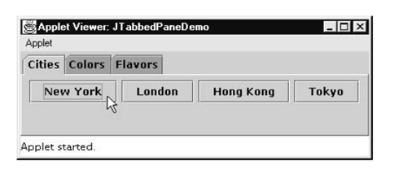
Tabbed Panes

Slide 73
Tabbed Panes
Tabbed panes are encapsulated by the JTabbedPane class, which extends JComponent.
Tabs are defined via the following method
void addTab(String str, Component comp)
  str→ the title for the tab,
  comp → the component that should be added to the
  tab.
Typically, a JPanel or a subclass of it is added.

Slide 74
Tabbed Panes
The general procedure to use a tabbed pane in an applet
Create a JTabbedPane object.
Call addTab( ) to add a tab to the pane.
Repeat step 2 for each tab.
Add the tabbed pane to the content pane of the applet.

Slide 75
Example
// Demonstrate JTabbedPane.
import javax.swing.*;
/*
<applet code="JTabbedPaneDemo" width=400 height=100>
</applet>
*/
public class JTabbedPaneDemo extends JApplet {
public void init() {
try {
SwingUtilities.invokeAndWait(
new Runnable() {
public void run() {
makeGUI();
}
}
);
} catch (Exception exc) {
System.out.println("Can't create because of " + exc);
}
}

Slide 76
Example
private void makeGUI() {
JTabbedPane jtp = new JTabbedPane();
jtp.addTab("Cities", new CitiesPanel());
jtp.addTab("Colors", new ColorsPanel());
jtp.addTab("Flavors", new FlavorsPanel());
add(jtp);
}
}
// Make the panels that will be added to the tabbed pane.
class CitiesPanel extends JPanel {
public CitiesPanel() {
JButton b1 = new JButton("New York");
add(b1);
JButton b2 = new JButton("London");
add(b2);
JButton b3 = new JButton("Hong Kong");
add(b3);
JButton b4 = new JButton("Tokyo");
add(b4);
} }

Slide 77
Example
class ColorsPanel extends JPanel {
public ColorsPanel() {
JCheckBox cb1 = new JCheckBox("Red");
add(cb1);
JCheckBox cb2 = new JCheckBox("Green");
add(cb2);
JCheckBox cb3 = new JCheckBox("Blue");
add(cb3);
}
}
class FlavorsPanel extends JPanel {
public FlavorsPanel() {
JComboBox jcb = new JComboBox();
jcb.addItem("Vanilla");
jcb.addItem("Chocolate");
jcb.addItem("Strawberry");
add(jcb);
}
}

Slide 78
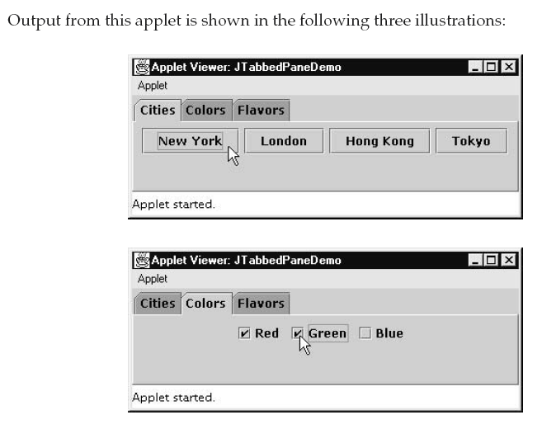
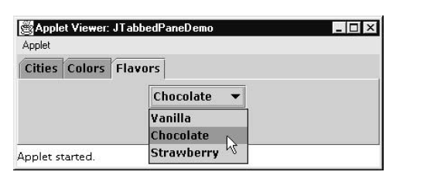
Example

Slide 79
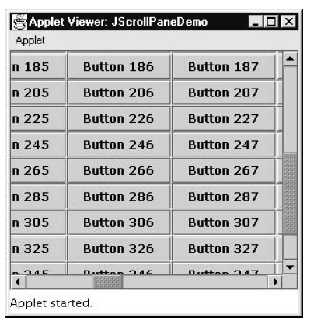
Scroll Panes

Slide 80
Scroll Panes
A scroll pane is a component that presents a rectangular area in which a component may be viewed.
Scroll panes are implemented in Swing by the JScrollPane class, which extends JComponent.
JScrollPane(Component comp)
JScrollPane(int vsb, int hsb)
JScrollPane(Component comp, int vsb, int hsb)
comp → the component to be added to the scroll pane.
vsb and hsb → define when vertical and horizontal scroll bars are
shown

Slide 81
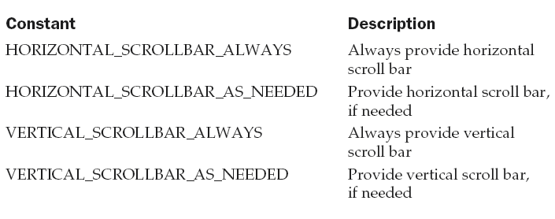
Scroll Panes
These constants are defined by the ScrollPaneConstants interface. Some examples of these constants

Slide 82
Scroll Panes
the steps that you should follow to use a scroll pane in an applet
Create a JComponent object.
Create a JScrollPane object.
Add the scroll pane to the content pane of the applet.

Slide 83
Example
// Demonstrate JScrollPane.
import java.awt.*;
import javax.swing.*;
/*
<applet code="JScrollPaneDemo" width=300 height=250>
</applet>
*/
public class JScrollPaneDemo extends JApplet {
public void init() {
try {
SwingUtilities.invokeAndWait(
new Runnable() {
public void run() {
makeGUI();
}
}
);

Slide 84
Example
} catch (Exception exc) {
System.out.println("Can't create because of " + exc);
}
}
private void makeGUI() {
// Add 400 buttons to a panel.
JPanel jp = new JPanel();
jp.setLayout(new GridLayout(20, 20));
int b = 0;
for(int i = 0; i < 20; i++) {
for(int j = 0; j < 20; j++) {
jp.add(new JButton("Button " + b));
++b;
}
}
// Create the scroll pane.
JScrollPane jsp = new JScrollPane(jp);

Slide 85
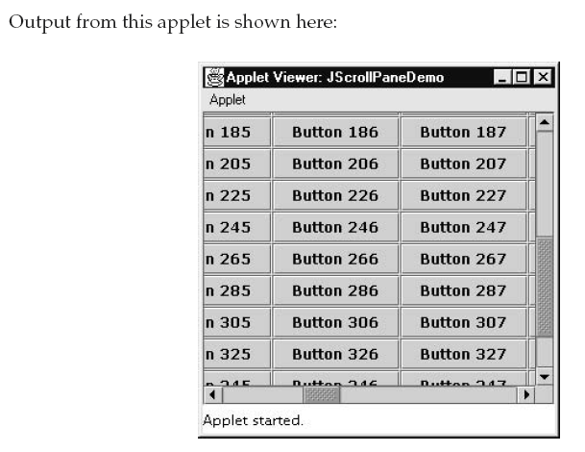
Example
/ Add the scroll pane to the content pane.
// Because the default border layout is used,
// the scroll pane will be added to the center.
add(jsp, BorderLayout.CENTER);
}
}

Slide 86
Trees
A tree is a component that presents a hierarchical view of data.
A user has the ability to expand or collapse individual subtrees in this display.
Trees are implemented in Swing by the JTree class, which extends JComponent.
Some of its constructors are shown here
JTree(Hashtable ht)
JTree(Object obj[ ])
JTree(TreeNode tn)
JTree(Vector v)

Slide 87
Trees
The first form creates a tree in which each element of the hash table ht is a child node.
Each element of the array obj is a child node in the second form.
The tree node tn is the root of the tree in the third form.
Finally, the last form uses the elements of vector v as child nodes.

Slide 88
Trees
A JTree object generates events when a node is expanded or collapsed.
void addTreeExpansionListener(TreeExpansionListener tel)
void removeTreeExpansionListener(TreeExpansionListener tel)
tel → the listener object

Slide 89
Trees
Methods
TreePath getPathForLocation(int x, int y)
→ used to translate a mouse click on a specific point of the tree to a tree path.
  x and y → are the coordinates at which the mouse is clicked.
  TreePath object encapsulates information about the tree node that was selected by the user.

Slide 90
Trees
Methods
The TreeNode interface declares methods that obtain information about a tree node.
The MutableTreeNode interface extends TreeNode. It declares methods that can insert and remove child nodes or change the parent node.
The DefaultMutableTreeNode class implements the MutableTreeNode interface

Slide 91
Trees
Methods
The DefaultMutableTreeNode class represents a node in a tree.
One of its constructors is shown here:
DefaultMutableTreeNode(Object obj)
obj → the object to be enclosed in this tree node. The new tree node doesn’t have a parent or children.

Slide 92
Trees
Methods
To create a hierarchy of tree nodes, the add( ) method of DefaultMutableTreeNode can be used.
  void add(MutableTreeNode child)
Child → mutable tree node that is to be added as a child to the current node

Slide 93
Trees
Methods
Tree expansion events are described by the class TreeExpansionEvent in the javax.swing.event package.
The getPath( ) method of this class returns a TreePath object that describes the path to the changed node.
TreePath getPath( )

Slide 94
Trees
Methods
The TreeExpansionListener interface provides the following two methods:
  void treeCollapsed(TreeExpansionEvent tee)
  void treeExpanded(TreeExpansionEvent tee)
tee → tree expansion event.
The first method is called when a subtree is hidden, and the second method is called when a subtree becomes visible.

Slide 95
Trees
steps that you should follow to use a tree in an applet:
Create a JTree object.
Create a JScrollPane object
Add the tree to the scroll pane.
Add the scroll pane to the content pane of the applet.

Slide 96
Example
// Demonstrate JTree.
import java.awt.*;
import javax.swing.event.*;
import javax.swing.*;
import javax.swing.tree.*;
/* <applet code="JTreeDemo" width=400 height=200>
</applet> */
public class JTreeDemo extends JApplet {
JTree tree;
JLabel jlab;
public void init() {
try {
SwingUtilities.invokeAndWait(
new Runnable() {
public void run() {
makeGUI();
}
}
);

Slide 97
Example
} catch (Exception exc) {
System.out.println("Can't create because of " + exc);
}
}
private void makeGUI() {
// Create top node of tree.
DefaultMutableTreeNode top = new DefaultMutableTreeNode("Options");
// Create subtree of "A".
DefaultMutableTreeNode a = new DefaultMutableTreeNode("A");
top.add(a);
DefaultMutableTreeNode a1 = new DefaultMutableTreeNode("A1");
a.add(a1);
DefaultMutableTreeNode a2 = new DefaultMutableTreeNode("A2");
a.add(a2);

Slide 98
Example
// Create subtree of "B".
DefaultMutableTreeNode b = new DefaultMutableTreeNode("B");
top.add(b);
DefaultMutableTreeNode b1 = new DefaultMutableTreeNode("B1");
b.add(b1);
DefaultMutableTreeNode b2 = new DefaultMutableTreeNode("B2");
b.add(b2);
DefaultMutableTreeNode b3 = new DefaultMutableTreeNode("B3");
b.add(b3);
// Create the tree.
tree = new JTree(top);
// Add the tree to a scroll pane.
JScrollPane jsp = new JScrollPane(tree);
// Add the scroll pane to the content pane.
add(jsp);

Slide 99
Example
// Add the label to the content pane.
jlab = new JLabel();
add(jlab, BorderLayout.SOUTH);
// Handle tree selection events.
tree.addTreeSelectionListener(new TreeSelectionListener() {
public void valueChanged(TreeSelectionEvent tse) {
jlab.setText("Selection is " + tse.getPath());
}
});
}
}

Slide 100
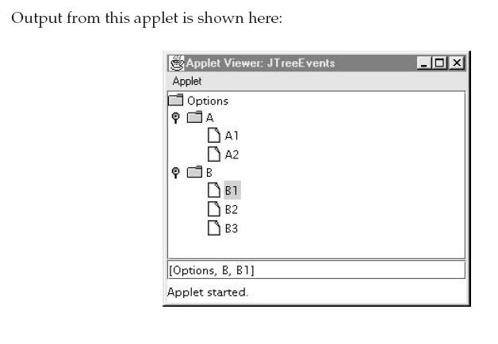
Example

Slide 101
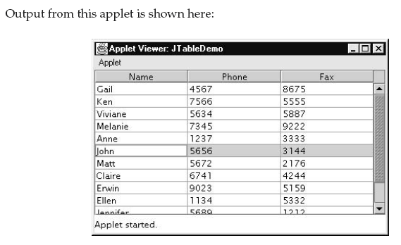
Tables

Slide 102
Tables
A table is a component that displays rows and columns of data.
You can drag the cursor on column boundaries to resize columns.
You can also drag a column to a new position

Slide 103
Tables
Tables are implemented by the JTable class, which extends JComponent.
One of its constructors is shown here:
JTable(Object data[ ][ ], Object colHeads[ ])
data → a two-dimensional array of the information to be presented,
colHeads → a one-dimensional array with the column headings.

Slide 104
Tables
the steps for using a table in an applet:
Create a JTable object.
Create a JScrollPane object.
Add the table to the scroll pane.
Add the scroll pane to the content pane of the applet.

Slide 105
Example
// Demonstrate JTable.
import java.awt.*;
import javax.swing.*;
/*
<applet code="JTableDemo" width=400 height=200>
</applet>
*/
public class JTableDemo extends JApplet {
public void init() {
try {
SwingUtilities.invokeAndWait(
new Runnable() {
public void run() {
makeGUI();
}
}
);

Slide 106
Example
} catch (Exception exc) {
System.out.println("Can't create because of " + exc);
} }
private void makeGUI() {
// Initialize column headings.
String[] colHeads = { "Name", "Extension", "ID#" };
// Initialize data.
Object[][] data = {
{ "Gail", "4567", "865" },
{ "Ken", "7566", "555" },
{ "Viviane", "5634", "587" },
{ "Melanie", "7345", "922" },
{ "Anne", "1237", "333" },
{ "John", "5656", "314" },
{ "Matt", "5672", "217" },
{ "Claire", "6741", "444" },
{ "Erwin", "9023", "519" },
{ "Ellen", "1134", "532" },
{ "Jennifer", "5689", "112" },
{ "Ed", "9030", "133" },
{ "Helen", "6751", "145" }
};

Slide 107
Example
// Create the table.
JTable table = new JTable(data, colHeads);
// Add the table to a scroll pane.
JScrollPane jsp = new JScrollPane(table);
// Add the scroll pane to the content pane.
add(jsp);
}
}

Slide 108
JToggleButton
A useful variation on the push button is called a toggle button. A toggle button looks just like a push button, but it acts differently because it has two states: pushed and released.
That is, when you press a toggle button, it stays pressed rather than popping back up as a regular push button does. When you press the toggle button a second time, it releases
(pops up).
Therefore, each time a toggle button is pushed, it toggles between its two states.

Slide 109
Toggle buttons are objects of the JToggleButton class. JToggleButton implements AbstractButton.
In addition to creating standard toggle buttons,
JToggleButton is a superclass for two other - that also represent two-state controls.
These are JCheckBox and JRadioButton, which are described later in this chapter. Thus, JToggleButton defines the basic functionality of all two-state components.
JToggleButton defines several constructors. The one used by the example in this section is shown here: JToggleButton(String str)

Slide 110
JToggleButton generates an action event each time it is pressed. Unlike JButton, however, JToggleButton also generates an item event. This event is used by those components that support the concept of selection.
When a JToggleButton is pressed in, it is selected. When it is popped out, it is deselected.
To handle item events, you must implement the ItemListener interface by ItemListener. Inside itemStateChanged( ), the getItem( ) method can be called on the ItemEvent object to obtain a reference to the JToggleButton instance that generated the event.

Slide 111
// Demonstrate JToggleButton.
import java.awt.*;
import java.awt.event.*;
import javax.swing.*;
/*<applet code="JToggleButtonDemo" width=200 height=80>
</applet> */
public class JToggleButtonDemo extends JApplet {
JLabel jlab; JToggleButton jtbn;
public void init() {
try {
SwingUtilities.invokeAndWait(
new Runnable() {
public void run() {
makeGUI();
} } );

Slide 112
} catch (Exception exc) {
System.out.println("Can't create because of " + exc);
} }
private void makeGUI() {
// Change to flow layout.
setLayout(new FlowLayout());
// Create a label.
jlab = new JLabel("Button is off.");
// Make a toggle button.
jtbn = new JToggleButton("On/Off");
// Add an item listener for the toggle button.
jtbn.addItemListener(new ItemListener() {
public void itemStateChanged(ItemEvent ie) {
if(jtbn.isSelected())
jlab.setText("Button is on.");

Slide 113
else
jlab.setText("Button is off.");
} });
// Add the toggle button and label to the content pane.
add(jtbn);
add(jlab); } }

Slide 114
Swing also lets you write directly into the display area of a frame, panel, or one of Swing’s other components, such as JLabel.
To write output directly to the surface of a component, you will use one or more drawing methods defined by the AWT, such as drawLine( ) or drawRect( ).
Painting Fundamentals
Because JComponent inherits Component, all Swing’s lightweight components inherit the paint( ) method. However, you will not override it to paint directly to the surface of a component.

Slide 115
The reason is that Swing uses a bit more sophisticated approach to painting that involves three distinct methods: paintComponent( ), paintBorder( ), and paintChildren( ).
These methods paint the indicated portion of a component and divide the painting process into its three distinct, logical actions.
To paint to the surface of a Swing component, you will create a subclass of the component
and then override its paintComponent( ) method. This is the method that paints the interior of the component.

Slide 116
When overriding paintComponent( ), the first thing you must do is call super.paintComponent( ), so that the superclass portion of the painting process takes place.
After that, write the output that you want to display. The paintComponent( ) method is shown :
protected void paintComponent(Graphics g)
To cause a component to be painted under program control, call repaint( ).
Inside the overridden paintComponent( ), you will draw the stored output.

